Slide 1
Line Coding
Line coding refers to the process of converting digital data into digital signals.
Whenever we transmit data it is in the form of digital signals.
With line coding, we can convert a sequence of bits (or encoding) into a digital signal which then again converted into bits by the receiver (or can be said as decoded by the receiver).
For all this to happen we need line coding schemes which could also be able to avoid overlapping and distortion of signals.
1001 --- 11100110 1100011001 101110 100010

Slide 2
Properties of Line Coding 11111001111100111 13T_{b}
DC Component:
When the voltage level in a digital signal is constant for a while, the spectrum creates very low frequencies (results of Fourier analysis). These frequencies around zero, called DC (direct-current) components, present problems for a system that cannot pass low frequencies or a system that uses electrical coupling (via a transformer).
Eliminating the dc energy from the signal power spectrum enables the transmitter to be ac coupled.
Magnetic recording system or system using transformer coupling are less sensitive to low frequency signal components.
Low frequency component may lost, if the presence of dc or near dc spectral component is significant in the code itself.

Slide 3
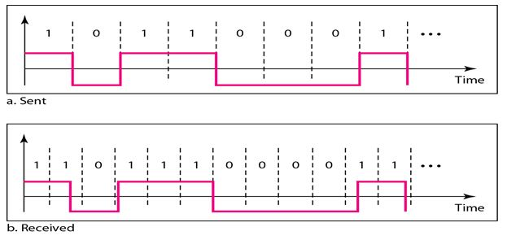
Self synchronization
Any digital communication system requires bit synchronization. Coherent detector requires carrier synchronization.
BIT 1 T1 TX T2 RX
T2-T1Delay
10001 1ms 10000
Error detection
Some codes such as duo binary provide the means of detecting data error without introducing additional error detection bits into the data sequence.
Bandwidth compression:
Some codes such as multilevel codes increase the efficiency of the bandwidth utilization by allowing a reduction in required bandwidth for a given data rate, thus more information transmitted per unit band width.

Slide 4
Differential encoding
This technique is useful because it allow the polarity of differentially encoded waveform to be inverted without affecting the data detection.
In communication system where waveform to be inverted is having great advantage.
Noise immunity
For same transmitted energy some codes produces lesser bit detection error than other in the presence of noise. For ex. The NRZ waveforms have better noise performance than the RZ type.

Slide 5
Spectral compatibility with channel
On aspect of spectrum matching is dc coupling. Also transmission bandwidth of the code must be sufficient small compared to channel bandwidth so that ISI-Intersymbol Interference is not problem.
Transparency
A line code should be so designed that the receiver does not go out of synchronization for any line sequence of data symbol.
A code is not transparent if for some sequence of symbol, the clock is lost.

Slide 6


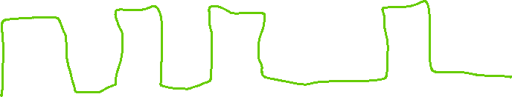

Baseline Wandering: In decoding a digital signal, the receiver calculates a running average of the received signal power. This average is called the baseline.
The incoming signal power is evaluated against this baseline to determine the value of the data element.
A long string of Os or 1s can cause a drift in the baseline (baseline wandering) and make it difficult for the receiver to decode correctly. A good line coding scheme needs to prevent baseline wandering.
1 0 1 0 1 0 0 0 1 0

Slide 7
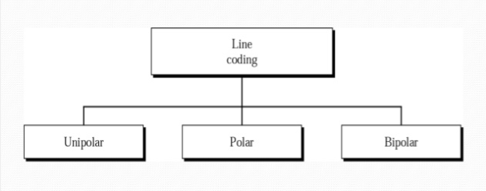
Types of Line Coding

Slide 8
Unipolar Line Coding
In Unipolar we are simply representing a signal in a graphical form where positive voltage represents logical or binary 1 and zero voltage represents logical zero.
It is the simplest line code.
The drawback of this scheme is that it is not
self-clocking which means that it can't be decoded without a separate clock signal or any other synchronization source.
As mentioned in properties of line codes, there should be no DC component present which it significantly contains, which can be halved by returning to zero in the middle of the bit period.

Slide 9
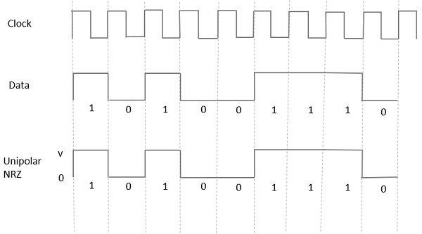
NRZ (Non-Return to Zero)
The term Non-Return to Zero (NRZ) means that the signal will not return to zero in middle of the bit (i.e. either 0 or 1).
Unipolar schemes were generally designed as NRZ schemes. But if we compare it to the polar NRZ scheme.
This scheme leads to wastage of power i.e. the normalized power (i.e. the power required to send 1-bit per resistance) is almost double as compared to polar NRZ.
Because of all these reasons unipolar encoding is not normally used in data communications today.

Slide 10
Advantages
The advantages of Unipolar NRZ are
It is simple.
A lesser bandwidth is required.
Disadvantages
The disadvantages of Unipolar NRZ are
No error correction done.
Presence of low frequency components may cause the signal droop.
No clock is present.
Loss of synchronization is likely to occur (especially for long strings of 1s and 0s).

Slide 11
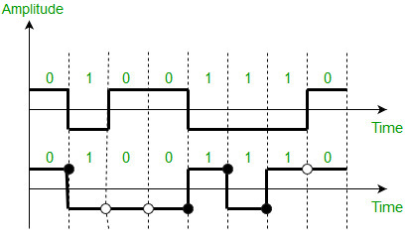
Polar Line Coding
As its name suggests polar which means it will have both positive and negative values for voltages or amplitude, it is quite like NRZ scheme but, here we have NRZ-L (i.e. NRZ-Level) and NRZ-I (i.e. NRZ Invert).
In the above diagram, we can simply notice that high volt is for logical 0 and low volt is for logical 1. This is the representation of NRZ-Level.
whenever we encounter logical 1 then the signal will be inverted, but when it encounters logical 0 then it remains on the same side. This is the NRZ-Invert.
The Baseline wandering is a problem for both of them, but for NRZ-L it is twice as bad as compared to NRZ-I, because of the transition at the boundary for NRZ-I.
Similarly, the self-synchronization problem is similar in both for a long sequence of 0’s, but for a long sequence of 1’s, it is more severe in NRZ-L.

Slide 12
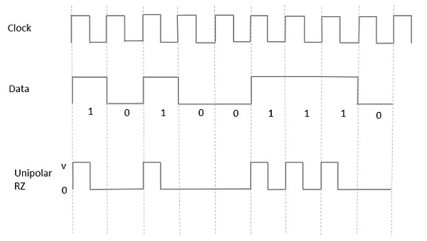
Unipolar Return to Zero (RZ)
In this type of unipolar signaling, a High in data, though represented by a Mark pulse, its duration T₀ is less than the symbol bit duration.
Half of the bit duration remains high but it immediately returns to zero and shows the absence of pulse during the remaining half of the bit duration.
Tb
Kb/Tb
Kbps/(Tb/2)
2Kb/Tb
Tb/2
Disadvantages
No error correction.
Occupies twice the bandwidth as unipolar NRZ.
The signal droop is caused at the places where signal is non-zero at 0 Hz.
Advantages
It is simple.
The spectral line present at the symbol rate can be used as a clock.
(Droop: bend or hang downwards)

Slide 13
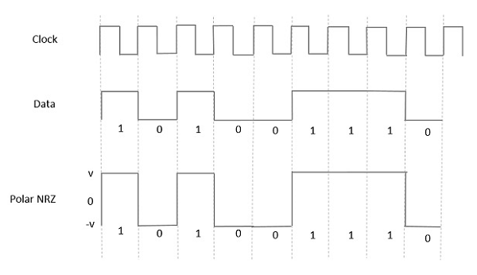
Polar Signaling
Polar NRZ
In this type of Polar signaling, a High in data is represented by a positive pulse, while a Low in data is represented by a negative pulse.
BIT INTERVAL= T_{b} RZ= T_{b}/2, f=2/ T_{b}
Advantages
It is simple.
No low-frequency components are present.
Disadvantages
No error correction.
No clock is present.
The signal droop is caused at the places where the signal is non-zero at 0 Hz.

Slide 14
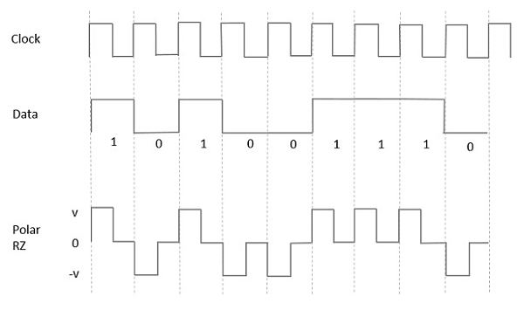
Polar RZ
In this type of Polar signaling, a High in data, though represented by a Mark pulse, its duration T₀ is less than the symbol bit duration.
Half of the bit duration remains high but it immediately returns to zero and shows the absence of pulse during the remaining half of the bit duration.
However, for a low input, a negative pulse represents the data, and the zero level remains same for the other half of the bit duration.
t
t/2
t/2

Slide 15
Advantages
It is simple.
No low-frequency components are present.
Disadvantages
No error correction.
No clock is present.
Occupies twice the bandwidth of Polar NRZ.
The signal droop is caused at places where the signal is non-zero at 0 Hz.

Slide 16
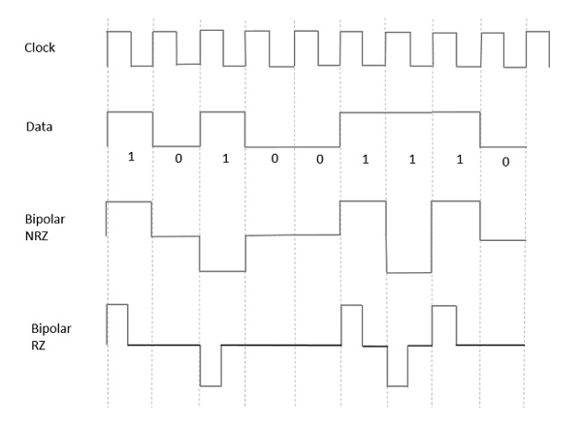
Bipolar Signaling
This is an encoding technique which has three voltage levels namely +, - and 0. Such a signal is called as duo-binary signal.
An example of this type is Alternate Mark Inversion AMI. For a 1, the voltage level gets a transition from + to – or from – to +, having alternate 1s to be of equal polarity. A 0 will have a zero voltage level.
Bipolar NRZ
Bipolar RZ
The pulse duration and symbol bit duration are equal in NRZ type, while the pulse duration is half of the symbol bit duration in RZ type.

Slide 17
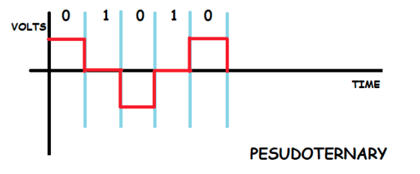
Pesudoternary: this is the opposite of AMI, as we kept logical 0 at 0 volts or neutral in the above section, here we will be keeping logical 1 as neutral (i.e. at 0 volts) and we will keep alternating logical zero

Slide 18
Advantages
It is simple.
No low-frequency components are present.
Occupies low bandwidth than unipolar and polar NRZ schemes.
This technique is suitable for transmission over AC coupled lines, as signal drooping doesn’t occur here.
A single error detection capability is present in this. 1010TX RX1000
Disadvantages
No clock is present.
Long strings of data causes loss of synchronization.

Slide 19
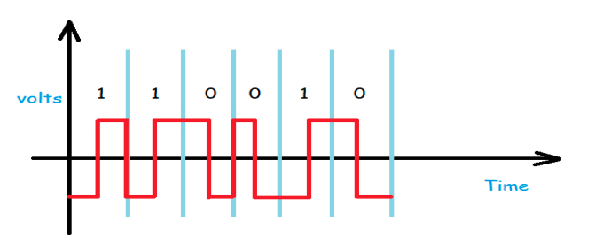
Manchester & Differential-Manchester Encoding:
Manchester encoding is a combination of RZ and NRZ-L.
Here, instead of using three values of voltages we use only two, here logical 1 is represented in two halves, the first half consists of a negative voltage and the second-half is represented as positive voltage,
and logical 0 is also represented in two halves, the first half consists of a positive voltage and the second-half is represented as negative voltage.
The transition in the middle of the bit provides synchronization.

Slide 20
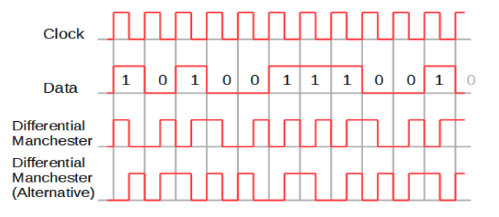
The Differential-Manchester encoding can be said as the combination of RZ & NRZ-I. here, we use the same logic as we used in NRZ-I i.e. inversion will take place when we encounter logical 1 and if we encounter logical 0 then no inversion.
Manchester encoding had a huge impact since it was able the solution for several problems related to NRZ-L
Differential Manchester overcome the problems associated with NRZ-I, since there is no baseline wandering and no low frequency component or DC component, because every logical bit was having positive and negative voltage contribution.
The area where Manchester encoding, and Differential Manchester encoding are limited is the bandwidth. The minimum bandwidth of Manchester encoding, and Differential Manchester encoding is twice as that of NRZ.

Slide 21
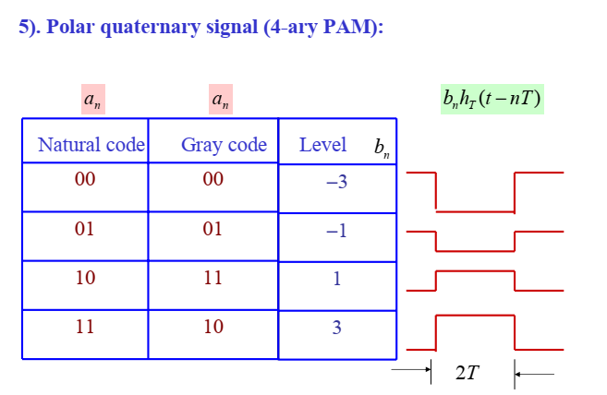

Slide 22
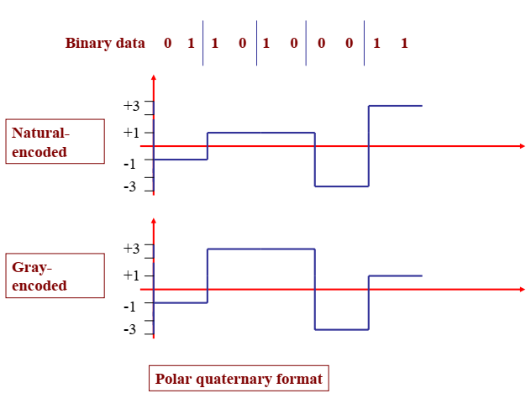

Slide 23
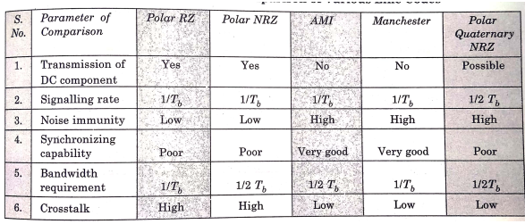

Slide 24
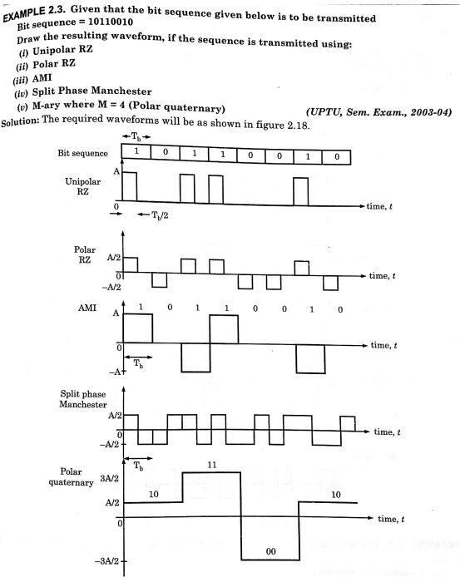

Slide 25

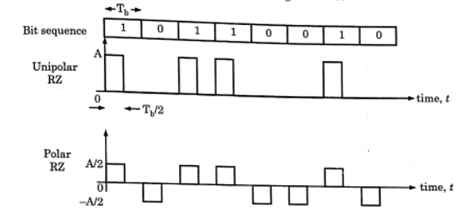




UNIPOLAR RZ
POLAR RZ

Slide 27

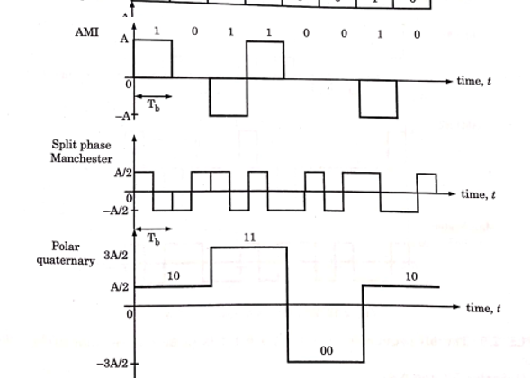
















00 de 0 -1
01 1 -2
10 2 2
11 3 3

Slide 28
